Slide 1
Robotics Workshop
For Mentorship Program

Slide 2
Workshop Outline :
Date | Event
24 March 2022 | Circuits & Arduino
25 March 2022 | Working Principle of Different Sensors
26 March 2022 | Line Follower Robot
27 March 2022 | Project Hunt
28 March 2022 | Project Hunt
29 March 2022 | Project Hunt

Slide 3
Team Alpha
Team Beta
Team Gama
Team Epsilon
Team Delta

Slide 4
Team Alpha
Shad & Joy Raj
Team Beta
Mowaz & Sajjad
Team Gama
Aditto & Nihal
Juniors (2019 Batch)
Team Delta
Afif & Razin
Team Epsilon
Pramit & Anwoy

Slide 5
Circuit
Arduino
Electricity
Voltage
Current
Resistance
Ohm’s Law
Resistance in Series and Parallel
Resistance Color Coding
Breadboard
About Arduino
Parts of the Arduino
Arduino IDE
Blinking LED with Arduino

Slide 6
Electricity
Static Electricity
Dynamic Electricity
Direct Current
Alternating Current

Slide 7
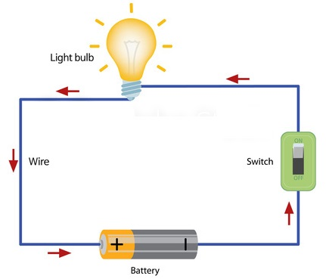

Slide 8
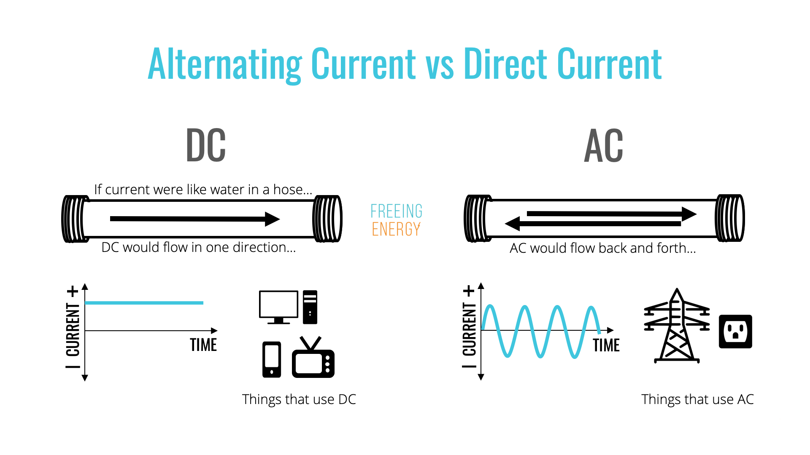
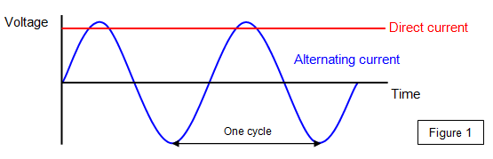

Slide 9
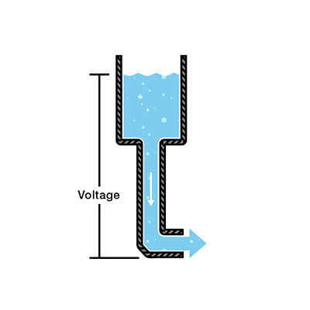
Voltage

Slide 10
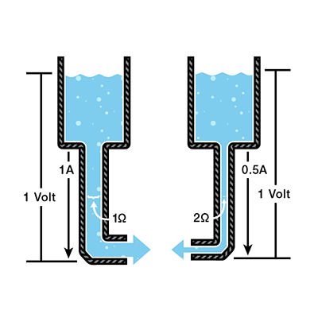
Current

Slide 11
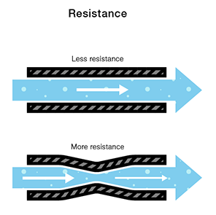

Slide 12
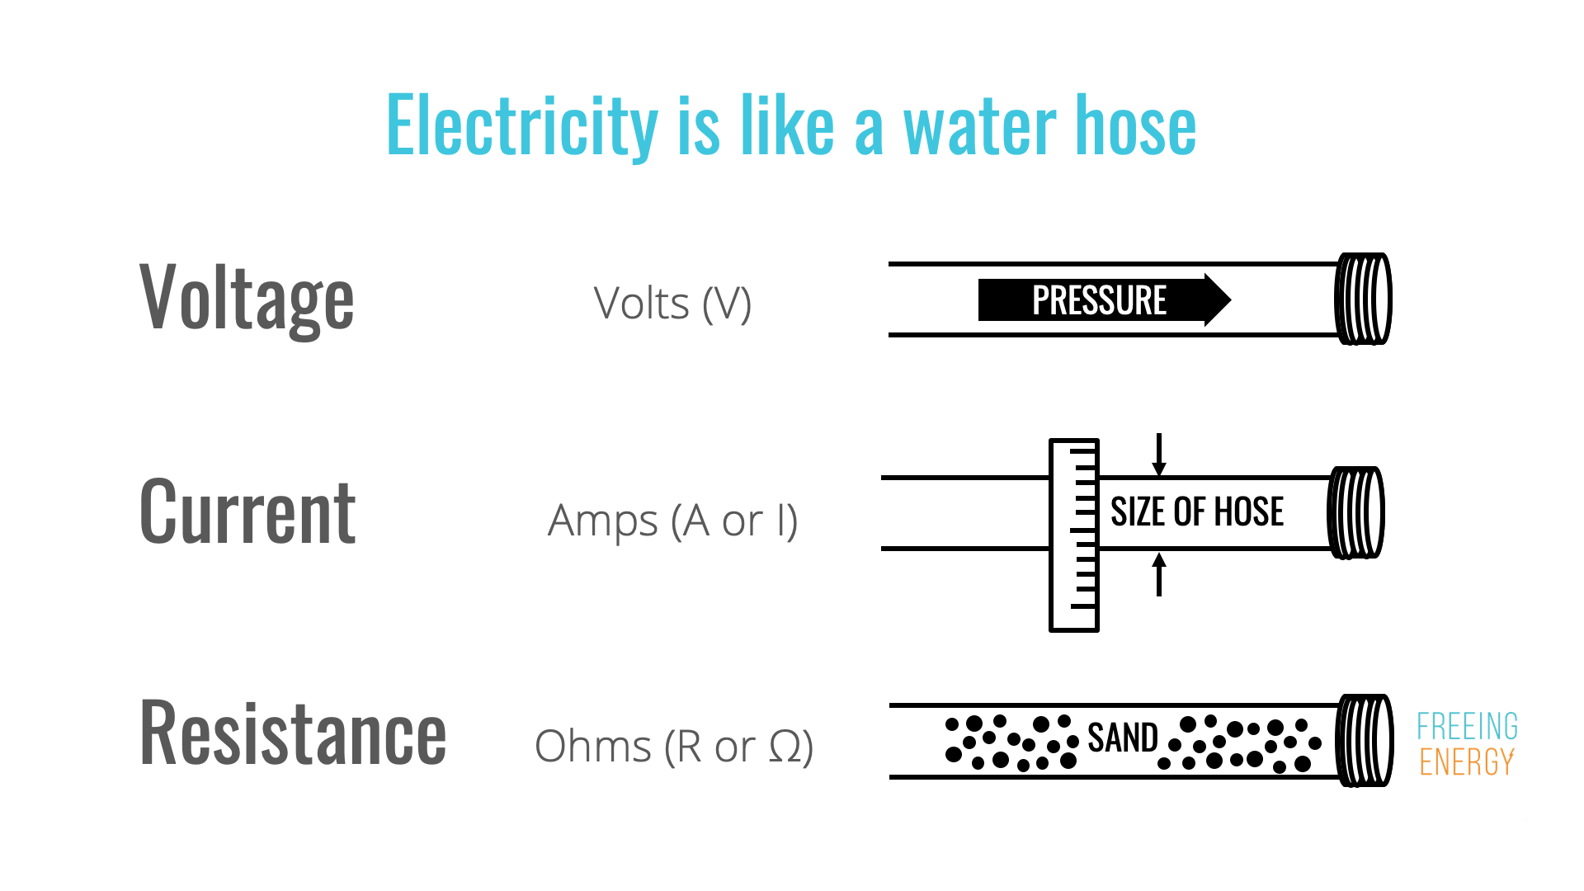

Slide 13
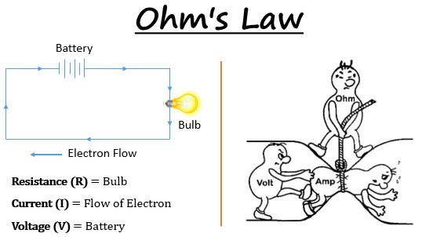

Slide 14
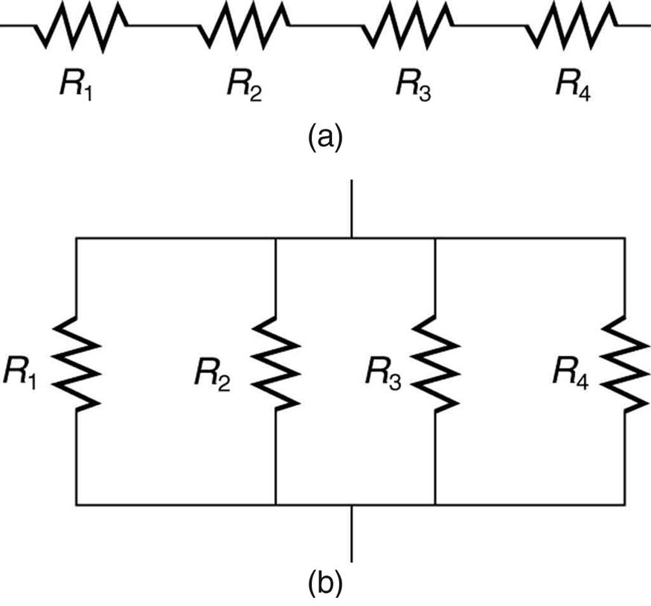

Slide 15
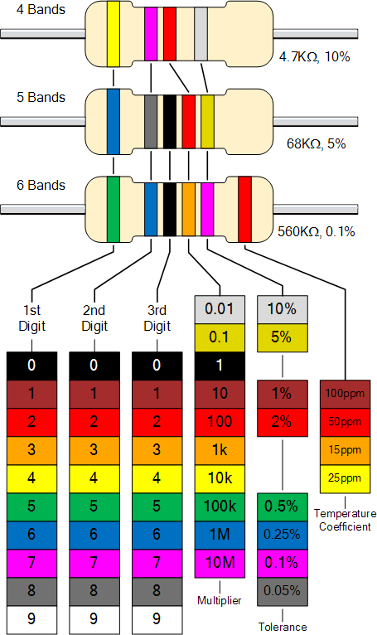

Slide 16
Arduino

Slide 17
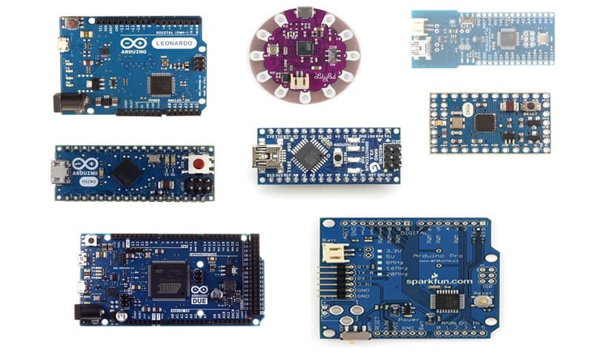

Slide 18
Arduino Specifications
Microcontroller : ATmega328
Operating Voltage : 5 V
Input Voltage (Recommended) : 7-12 V
Input Voltage (Limits) : 6-20 V
Digital I/O pins : 14 ( PWM pin = 6)
Analog Input Pins : 6
DC Current per I/O pin : 40mA
DC Current for 3.3V pin : 50mA
Flash Memory : 32 KB
Clock Speed : 16 MHz

Slide 19
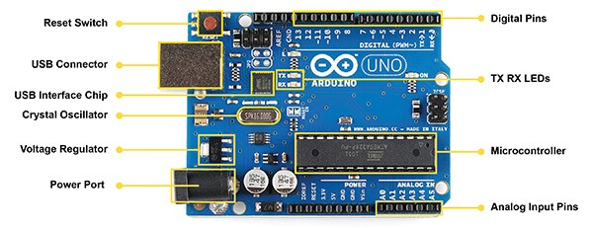

Slide 20
